Slide 1
Linked List, Stack, and Queue
Il-Chul Moon Dept. of Industrial and Systems Engineering KAIST
icmoon@kaist.ac.kr
Notes:
This week, we are going to examine the three types of primary data structures, which are linked list, stack, and queue.

Slide 2
Weekly Objectives
This week, we learn the first set of data structures: linked list, stack, and queue.
Objectives are
Understanding the definition of abstract data types
Firmly understanding how references work
Understanding various linked list, stack, and queue structures
Singly linked list, doubly linked list, circular linked list…
Able to implement a stack and a queue with a list
Understanding the procedures of linked list, stack, and queue management
Insert, delete, search…
Should be able to estimate the number of steps for inserts, deletes, and searches
Notes:
What we’ll cover for this week includes the following.
We’ll get into the three interrelated data structures in the following order: linked list, stack, and queue.
The thing that they all have in common is that they are linear.
Our first objective is to understand what an abstract data type is.
Secondly, we’ve discussed about a reference structure in the Python lecture.
To be able to implement a data structure, we’ve got to know exactly how this reference operates.
Understanding how this works will help us implement a data structure later.
We also have to understand the structures of a list, a stack, and a queue.
Linked lists can be classified into singly linked lists, doubly linked lists, circular linked list, and so on. This week, we’ll learn about singly linked lists.
Using a singly linked list enables us to implement a stack and queue.
Finally, we should look at not just the data structure itself, but also how it works.
Thus, we will study how to conduct three functions: insert, delete, search.

Slide 3
Array for List
Notes:
First, this is called an array in other programing languages.
In Python, there is a list which corresponds to an array.
Let’s find out how we can store and control linear data with them.

Slide 4



Scenario for List
You are looking for Koh in the mass public
You are going to ask one by one “Are you Ms. Koh?”
Sometimes, you ask the question to a person multiple times
You realize that this is not going to work!
So, you line up the people and again ask the question one-by-one
You are looking for a restroom on the floor
The floor has a long corridor, and every room has an entrance to the corridor
You only need to follow the corridor
You have a dump of information of customers
How to store, search, and manipulate the information
You line them up as a list!
Notes:
Most of all, let’s consider why we would need a thing like a list.
For instance, let’s say that you are searching for a person named Koh in a crowd.
How can we locate this one person among all these different people?
If we are to find a person without using any sort of order or organization, it would not just be highly inefficient but also difficult to accomplish the job.
What we can do in reality is get all these people to stand in lines.
Then, if we choose to check them one by one from the beginning of the lines, this task would be much easier.
That’s why we sometimes need to arrange a chaotic, entangled state into a linear form.
Again, let’s think about another example. Let’s say we need to find the restroom somewhere in this long hallway.
We will assume that this hallway is very long, and all rooms are accessible through doors in the hallway.
When you keep on proceeding along the hallway, you will eventually find a restroom.
This is the merit of design. You’ll eventually find a restroom somewhere along the hallway, and you don’t need to be provided details on how to find it.
We can find it as we continue following a linear space.
In addition, let’s say that you have some information on various purchasers.
You attempt to provide your customers with the appropriate services by seeking and accumulating such information.
To perform these tasks well, it is necessary to store the information in a structured manner.
One of the easiest, most accessible methods is to use a list.

Slide 5
Abstract Data Types
An abstract data type (ADT) is an abstraction of a data structure
An ADT specifies:
Data stored
Operations on the data
Error conditions associated with operations
Example: ADT modeling a simple stock trading system
The data stored are buy/sell orders
The operations supported are
order buy(stock, shares, price)
order sell(stock, shares, price)
void cancel(order)
Error conditions:
Buy/sell a nonexistent stock
Cancel a nonexistent order
Operations
Data Stored
Notes:
Before we proceed any further, let’s briefly touch upon the concept of an abstract data type.
An abstract data type is, simply put, the abstraction of a data structure.
What does that mean?
You may have learned about abstract painting in high school.
If we literally depict the reality to the smallest detail in a painting, it won’t be an abstract painting.
An abstract painting is able to simply manifest what is present in reality by translating it with intrinsic curves and contours according to the painter’s feeling or basic forms.
Then what is the significance of an abstract painting for a specific data structure?
A data structure accommodates a range of different operations: storing, searching, entering, or removing data.
It would not be an abstract painting if every single thing is minutely reflected and expressed.
So, an abstract data type is a form of expression of various behaviors in an abstract manner.
An abstract data type tells us what kinds of data are stored and which operations are allowed.
There is another critical element in an abstract data type. While we will not deal with this topic for now, it is of great importance in reality.
I’m talking about an error condition, which we won’t cover here.
An error will take place when a “remove” command is issued, but there is no specific item to delete. Another example is if the system is instructed to “store” data, even though there is no more space to store it.
Therefore, it is highly important to predict possible conditions prone to errors and to take appropriate measures.
At this point, however, we are not familiar with the types of data and how to operate them, so we will skip that part for this lecture.
Now, let’s imagine this situation.
Suppose that an abstract data type is modeling some stock trading system.
It is imperative for the system to memorize the buying and selling of orders.
It should have an order book that stores all the orders to buy. It also sells certain stocks from security account holders.
While there are a variety of ways to define all of them in detail, it is not clear how they operate from the outside. Consequently, what types of data are stored and which arithmetic operations are conducted should be specified—this is how you make abstract data types.
Thus, let’s say we are going to store such an order.
In that case, they will store something to accommodate arithmetic operations.
We may also specify in an abstract data type that some specific types of orders would be canceled.
Then, we should be able to define an error condition.
By predicting a potential source of error, we may issue the relevant error message or take some step (like avoiding that specific situation somehow).
For instance, we should prepare for any impossible orders, such as buying order for non-existing stocks or an order not to sell. Then, we can take the proper measure.
We have no clue as to how data is stored inside an abstract data type, just like we don’t know what’s inside this pocket.
An abstract data type specifies data and arithmetic operations that exert influence over what’s within.

Slide 6

Creating a List by Array
Array (in our Python example, List, yet we will use only its index function)
Each element is accessible by index
Index is typically zero or a positive integer
Very simple creation
That’s why people use it
x[0]
x[1]
x[2]
x[3]
x[4]
‘a’
‘b’
‘d’
‘e’
‘f’
Notes:
Now, let’s presume that we are about to construct an array using a list in Python.
The term, array, follows a conventional appellation in programing languages. In Python, what assumes the role of an array is called a list.
Basically, an array in general program languages refers to the storing and accessing of identical data based on an index.
Each element should accompany an index.
This is the definition of an array or list named x, which includes a, b, d, e, f.
And here, a comma (,) is introduced to discern elements.
In Python, the first index begins with 0.
Therefore, it is x[0] = “a”. The index will ascend in consecutive order.
Making such a list is quite simple.
In other languages, we have to define a size first, followed by the data type.
In Python, defining an array is very simple.

Slide 7
Search procedure in array
Let’s find ‘d’ and ‘c’ from the list in an array
Of course, you can use ‘in’, but we commit ourselves to use indexes only
Then, navigating from the first to the last until hit is the only way
x[0] == ‘c’ → False: No hit!
x[1] == ‘c’ → False: No hit!
x[2] == ‘c’ → False: No hit!
x[3] == ‘c’ → False: No hit!
x[4] == ‘c’ → False: No hit!
x[0]
x[1]
x[2]
x[3]
x[4]
After five retrievals,
we found that there will be no hit! (always N retrievals)
‘a’
‘b’
‘d’
‘e’
‘f’
After three retrievals,
we found the hit! (maximum N retrievals)
x[0] == ‘d’ → False: No hit!
x[1] == ‘d’ → False: No hit!
x[2] == ‘d’ → True: Hit!
Notes:
Let’s suppose we are seeking some data in an array.
Now we are going to find out b and c in the array defined before.
Someone has stored an array containing a, b, d, e, and f.
Let’s find out if we can locate b or c after a while.
Since Python uses a list, we can also employ “in”.
For instance, “d” is in x. When we check if “d” is present in x, it will produce a value of True (if it is there) or False (if it is absent).
However, this is a service provided by Python.
As it is one of Python’s reserved words, it is not applicable in other languages.
As an exercise, we will carry out a process to detect some elements by navigating an index.
Now we will traverse and search from the first to the last elements.
As it increases in one direction such as 1, 2, and 3, there is only one way to go.
The last element here is fixed.
Let’s briefly go over what we’ve previously learned before.
If we are to obtain the length of the list, we should use a command, len, to get len(x) = 5.
We can apply a “for” loop to proceed from 0 to length.
If it is 0, as x[0] = “a”, it is not “c”.
Likewise, x[1], x[2], x[3], or x[4] are not “c”.
Although we’ve retrieved as much as the value of len(x), we cannot find an index, “c”.
That means, there is no element of “c” in the list array.
If we are to confirm that it is not available on a list, how many times do we have to compare it?
We have to compare as long as the length of the array.
If we do not track down everything in the list, then we would look in the elements left unsearched.
We have to comb through every element.
To be able to confirm the presence of an element in a certain list, we need to at least compare as much as the length of the array or the number of data stored.
Let’s look at this from another perspective by considering the case of “d”.
Again, we will run a “for” loop from 0 to the length of the array.
x[0] is “a”, which is not equivalent to “d”. x[1] is “b”, which is also not the same as “d”. But as x[2] is equal to “d” and is thus True, it is possible to escape from the “for” loop.
At this point, we will see that “d” is present in the array.
In searching for “d”, we’ve compared the array three times.
If what we are looking for is found in the array, we can ensure that it can be located by searching through the entire length of the array.
If this length is shorter than the total length, we cannot guarantee that it would be found in the search.
If we assume that it is in the last place, we have to compare as long as N (the length of an array). That’s because we would find out about the presence of that element at the very end.
In the worst case, we have to search for it N times.
If we are fortunate enough. we could find it by comparing them several times. Otherwise, we have to search N times.

Slide 8
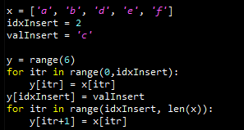
Insert procedure in array
Let’s insert ‘c’ between ‘b’ and ‘d’ in the list ( a = insert position index )
First, make new list, or y, with six cells
Second, copy the reference links of x[0:a-1] to y[0:a-1] (retrieval cnt.: a)
Third, put a reference link to ‘c’ in y[a] (retrieval cnt.: 1)
Fourth, copy the reference links of x[a:] to y[a+1:] (retrieval cnt.: n-a-1)
Fifth, change x’s reference to y’s reference
Total count of retrievals = a + 1 + n – a – 1 = n
x[0]
x[1]
x[2]
x[3]
x[4]
‘a’
‘b’
‘c’
‘d’
‘e’
‘f’
y[0]
y[1]
y[2]
y[3]
y[4]
y[5]
Notes:
This time, we will learn about the process called insert, which puts information in the middle of an array.
We know that the array that includes “b” and “d” does not have “c”.
At present, the array consists of a, b, d, e, and f. Now, let’s suppose that we want to introduce “c” to the array.
We are going to add “c” in the 2nd place in the row.
How can we place it into the array?
This requires us to undergo a somewhat complicated process.
First, we have to produce a new array that has 6 cells called “y”.
Here, y has strange values inside, whereas x does not have any values.
We are producing a list that could accommodate “c”.
The range (6) allows us to access the space of y that has 6 cells.
Second, we shall copy the reference.
We will proceed with the copy right before the space to be stored.
It will be interrupted up to here. The previous and new lists will have identical values up until this point.
Thus, “a” in the x[0] of the cell here is a type of instance of the object.
In other words, what points this out is the reference structure that we’ve learned in the week we focused on Python.
This reference copies and brings in the arrow. We use the arrow to indicate this instance, directing y to point out the same thing.
Likewise, to indicate the same thing, we copy this arrow here so we can use it.
We then dispose of what’s in that place to accommodate some new values.
If we look at it in the code, it looks like this.
As “itr” is larger than 0 and less than “idxInsert”, we will copy the reference from just before.
Now we are going to fill in the values to store them where we want in the new array.
In the code, it looks like this.
Since it was not stored previously, it will be stored as a new reference.
We then have to store the rest of the values of x, 2,3, and 4m to the 3, 4, and 5 of y.
Now, we have to stop here and perform a task for the remaining part.
As we inserted a new element to the x[a:] via a “for” loop, we will store them in the index with the addition of 1.
In actual code, the +1 here is the consequence of what’s stored above.
After that, since we intended to place it in x, but we actually put it in a new array, y, we should switch them.
Lastly, we shall put x = y to save the reference of y that is stored somewhere else.
This will make a call to x to indicate the array below.
The program will discard the previous data and access the new data by means of a new array.
However, we’ve already accomplished what we wanted.
Because, the c in the middle is in y. We access y via x. This is basically the same things as putting c into x in the end.
Let’s find out how many arithmetic operations were conducted through this process.
If we are put c into a, we need “a” operations. When c is inserted, we need 1 time of operation. For the following elements, n - a - 1 operations are required.
So, we need to perform operations n times.
This is actually quite natural. It’s basically the same thing as copying all of the elements here with an extra copy.
Therefore, if we are to fill something with an array, we need “n” search retrievals. If our code is inefficient, it may exceed n, but hopefully not as much as n² or n³.

Slide 9
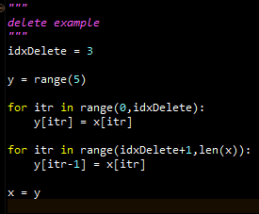
Delete procedure in array
Let’s remove ‘d’ in the list ( a = delete position index )
First, make new list, or y, with five cells
Second, copy the reference links of x[0:a-1] to y[0:a-1] (retrieval cnt.: a)
Third, copy the reference links of x[a+1:] to y[a:] (retrieval cnt.: n-a-1)
Fifth, change x’s reference to y’s reference
Total count of retrievals = a + n – a – 1 = n - 1
x[0]
x[1]
x[2]
x[3]
x[4]
x[5]
‘a’
‘b’
‘c’
‘d’
‘e’
‘f’
y[0]
y[1]
y[2]
y[3]
y[4]
Notes:
As we tackled insertion before, now we will cover the opposite—deletion.
Deleting an element in an array is similar to inserting.
Let’s suppose that we are going to remove “d”.
In the previous slide, the values 0, 1, 2, 3, 4, and 5 were stored.
We will eliminate the 3rd element, d.
Just like the case where we inserted a value in x, we cannot immediately delete “d”.
We make a new array called “y” and add each element in x.
Likewise, we will make a small array and copy the everything except the element we want to delete.
We will generate a new array in the same manner as before, but it will have one less cell—the new array will have five cells only.
Secondly, the elements that are located before the target element should point to the same values. We just copy them as they are.
Then, we will adopt a “for” loop just to copy all the values right before the location of the target element.
While we need an extra calculation for the insertion to add a new element to x, we won’t do anything in this part for deletion.
Here we have index, 4, and the new one is featured as 3.
As we have to remove one element, we also have to reduce the index.
Likewise, it is 5 here, but it becomes 4 below.
We will reduce the index to store values in this manner.
We will store the element in one place further forward from the original location, where one index is removed.
Finally, we will copy the different reference structures of the two arrays. The accesses situated in x will point at the array in y.
How many total operations do we need to perform this deletion process?
Despite the presence of 6 elements, one of them did not play any role. In this case, we need 5 operations.
So, we performed n - 1 operations.
If there are 10,000 elements, we will need “n: operations, whether it be 10,000 or 9,999.

Slide 10

Problems in Array
Whenever you put something in or get something out
You have to perform line-wise retrievals
Which is N retrievals (by assuming 100,000 – 1 ≒100,000)
This process is just like that
There is a line of airline passengers
You want to put a passenger in the middle of the line because his flight is about to leave
You are moving all the passengers one step back
Then, you put the customer in the line
What-if we have a magic to create a space in the middle of the line?
Array → you are bounded to the 1-dimension that you have
Linked list → you are bounded no more!
From Harry Porter
Notes:
So far, we’ve seen “insert” and “delete” in an array.
The array entails various problems in its use. One of the biggest issues lies in the line-wise retrieval occurring during any insertion or deletion task.
If we intend to add or remove one element, we need retrieval steps for “n” times.
It wouldn’t matter much if n is 5 or so. However, if it is 1,000,000, we have to copy all 1,000,000 elements to add a single element.
That’s an absurd operation.
Let me cite an example.
Some airline passengers are standing in line. They’re in a queue.
Then we have to add a pink person in the queue here.
To add the pink person to this specific location, we have to leave them here as they are. But we have to move this part by conducting one step, + 1, before inserting the person to make a new line. That’s how the operation based on an array would work.
This method requires all the elements to move. Isn’t that cumbersome?
On the contrary, if we insert it in the middle, we have to move all the elements one cell backward without the automatic creation of a space.
Thus, it’s a significant issue since we have to handle the entire array to insert or delete just one element.
It’s impossible to do this in reality.
Let’s consider the following case.
There is a magician who makes a space in between people to make room for another person.
How could we do this kind of magic?
As software is artificially created, people may intervene to generate a desired operation.
Can we make a space in the middle of an array?
Yes, we can.
However, we may no longer be able to call it an array.
It would not take place in this one-dimensional, linear space.
If we maintain the linear space, how can we make a new space?
If we are to store such a linear feature in data, it is impossible.
It will eventually take a linear shape, so it should not be stored by using an index in order to allow data insertions.
While we will approach the array based on index, the newly introduced concept, a linked list, is not stored in one-dimensional space that is defined in equidistant terms.
Perhaps you’ve seen one of the Harry Porter movies.
Those movies featured something similar to what we’re considering.
Here’s what I’m talking about in the film: when an actor attempts to enter a building, a new building appears between the buildings.
Just like the way a new building emerged in the movie, the method that creates a new space by pushing elements of both sides off is called a linked list. It should be applied to methods when the mere array approach isn’t feasible.

Slide 11
Linked List
Notes:
Now, let’s examine what is a linked list. It is unlike the previous array since it uses a reference structure rather than an index structure. This is what allows it to create spaces in the middle.

Slide 12
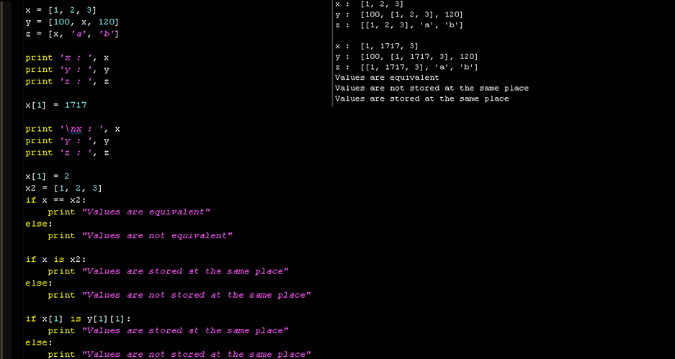
Detour: Assignment and Equivalence
y
1
x
3
reference
x
1
2
3
reference
One variable’s value is changed
But, you see three changes
Why this happened?
Because of references
x has two references from y and z
The values of y and z are determined by x, and x is changed
See the ripple effects
==
Checks the equivalence of two referenced values
is
Checks the equivalence of two referenced objects’ IDs
z
x
a
b
Notes:
We’ve seen this slide before.
We’ve already learned this in the lecture on Python.
The gist of the slide is a reference structure.
If you look here, you will find a well-defined list, x.
The list x is allocated to the 1st place of z and the 2nd place of y.
x can be stored in the 2nd place of y.
Y is designed to pinpoint where x is stored.
z does not just accept the value of x. It’s made to indicate the location of x.
That’s where the reference pointing to x is stored.
Therefore, when x is printed, it will print 1, 2, 3. When y is printed, it will print 100. Whatever pointed out x will call the value of x to be printed, which is 120.
Suppose the value of x is changed to another value.
Let’s assume x[1] will be replaced by 1717.
Now, the 2nd element of x is not 2 but 1717.
If we print out y, we will get [100, [1, 1717, 3], 120].
Although we did not modify anything in y, since y references x and x was changed, the print out of y will reflect the modified value of x. That’s how a reference structure works.
Now, how can we see if we’re dealing with a reference structure?
We have to be able to discern between a case when something is equal in value or a reference.
x2 stores these values: 1, 2, and 3.
Here, the values of x2 and x are identical.
Thus, the value is equivalent.
However, they are not stored in the same place.
In other words, we have to understand that having the same values differs from being stored in the same place.
The slide shows that if the value of the stored place is modified, the other values pointing to that same place will also be changed, accordingly.
To be able to implement a linked list, you need to understand this first.

Slide 13
Basic Structure: Singly linked list
Construct a singly linked list with nodes and references
A node consists of
A variable to hold a reference to its next node
A variable to hold a reference to its value object
Special nodes: Head and Tail
You can construct the singly linked list without them
But, using them makes search, insert and delete more convenient
Generally, requires more coding than array
Object
N e x t
Object
N e x t
Object
N e x t
Object
N e x t
Head
Tail
‘a’
‘b’
Notes:
Let’s explore the basic structure of a linked list
There is a singly linked list.
A singly linked list consists of a node and reference.
We already introduced nodes in this lecture.
As a node is basically made up of two variables, it is formed with classes.
The 1st variable indicates the next node.
This is a reference structure for storing another node.
The other variable specifies what type of value is to be stored.
Finally, there are special nodes.
In special nodes, there is a head and a tail.
While it is not necessary to store the head and tail for a singly linked list, they are very useful.
The head is the 1st node in the list. The following node is the one with the values.
There is no node that points out the head.
The tail is the last node, and it does not point to any node.
In general, this is the reference structure of the singly linked list.
Let’s say the two square boxes are a node.
The node is divided into two variables: one to indicate an object, and the other pointing out the next.
This one in particular is called the head, and no node points it out. The next will indicate the first node that contains some values.
As the object is a special node, or head, it does not store values.
Just like the variable containing a list that we’ve seen, the next refers to another node.
Likewise, the object has an object, and the next has the value, “a”.
The next node also has another reference that stores the “next”.
The next node is composed of two reference variables: an object that contains values and the next. The object stores “b”.
The next stores the reference of the next node.
The “next” is a special node called a tail. This object doesn’t store any values, and it doesn’t point to anything.
In Python, a single sentence can be sufficient to complete a list.
A linked list is pretty complicated.
The advantage of this complex structure can be found in its capability to handle a reference structure in the middle to immediately create a space.
You’ve got to fully understand the things inserted here and there—this is what I mean by a reference.
If the “next” is changed into somewhere else, it will lose the ability to find the next.
That’s why we need a mechanism to generate a space in the middle.
The “next” will serve to point to another next node. You should understand that when a node is changed, the reference should be within the next.

Slide 14
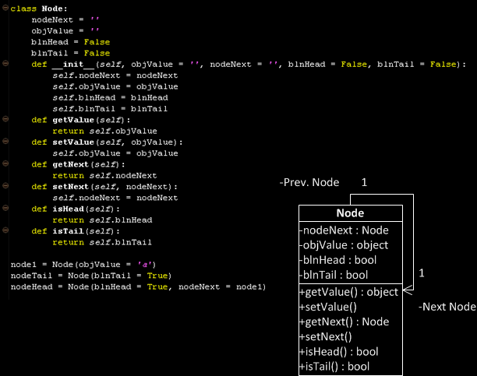
Implementation of Node class
Member variables
Variable to reference the next node
Variable to hold a value object
(Optional) Variable to check whether it is a head or not
(Optional) Variable to check whether it is a tail or not
Member functions
Various set/get methods
Notes:
Now let’s consider how to generate a node.
We’ve discussed that the fundamental form of a node can be divided into a reference for the next node and the value of the object to be stored.
This is the definition of a node.
It is designed to carry the next node and an object value.
Here is a Boolean variable to inform you whether it is a head or tail.
You’re not required to include it, but I added it for the convenience of implementation.
This is a constructor.
Here, you will find objValue and nodeNext as well as blnHead and blnTail
It shows that the accepted detail is stored in the member variable in a class.
Next, there are six methods.
The methods are actually quite simple.
“getvalue” will bring values. To newly store a value, you can use “setValue”. “getNext” is used to identify what’s the next node. You can store values with “setNode”, which stores the next node.
Finally, there are “isHead” and “isTail”. Those methods allow us to use “blnHead” and “blnTail”.
Thus, it can be said that a node is a feature that can store nodeNext and an object value like this.
If we turn them into UML, we get the following.
What’s intriguing is the association relation here.
The association relation is based on one-to-one,
What I mean by one-to-one is that one node can only have the next node.
A single node is only allowed to have one next node.
The association relation originates from this nodeNext.
So far, we’ve generated node classes.
We applied a class instance to put two variables into one instance.
It would be difficult to make a linked list without a class.
That’s because we have to handle two variables as a single node.

Slide 15
Head and Tail
Specialized node
Head : Always at the first of the list
Tail : Always at the last of the list
These are the two corner stone showing the start and the end of the list
These are optional nodes.
Linked list works okay without these
However, having these makes implementation very convenient
Any example?
Empty Linked List
Object
N e x t
Object
N e x t
Head
Tail
Linked List with Two Nodes
Object
N e x t
Object
N e x t
Object
N e x t
Object
N e x t
Head
Tail
‘a’
‘b’
Notes:
In this slide, we will implement head and tail using the node implementation methods that we’ve covered.
“head” and “tail” are special nodes.
The reason why they are special is that they are situated in fixed locations.
The head is always the first element, and the tail occupies the last in a linked list.
If there is no content in a linked list, the head will come first, followed by the tail.
This means that when a list has no value, the head adjoins the tail.
Just like the implementation of the previous nodes, the head and tail have one reference and one node pointing at an object and the next, respectively.
The head has no previous reference from elsewhere.
You don’t need to pay too much attention to whether or not you understand the head coming from elsewhere. You do need to know what the next is pointing to, though.
If it is an empty linked list, the head can simply designate the tail.
The next tail is still a node. It has an object and the next, which does not direct anything.
So, the next will either contain a garbage value or point to nowhere.
Now, the head and tail carry objects.
The object does not store any content.
Therefore, the object here does not point to anything.
Thus, the head and tail assume a significant role of indicating the start and end of the linked list.
A corner stone is used to restrict the range of a house by placing stones before building up any walls.
This is analogous to the head and tail in a linked list as they indicate up to which point the data can be assigned.
In fact, the head and tail are not indispensable for implementing a linked list, but they still facilitate the iteration process.
They are adopted for the purpose of ensuring convenience.
Here, it represents two nodes.
The objects of the head and tail have nothing in them. The rest should have meaningful content, though.
The head points to the first node of the linked list.
The object of the node points at “a”.
The next directs to the next node and the object of the node points to “b”.
The next one points to the tail.
The list does not go on any further.
So, we can see that “b” is the last node.
That’s the way how the head and tail inform us of the range of a list.
Later, if the head and tail are stored in the class that lists the head and tail, we can access the start of the list and be informed about this.
Now, the list will have two member variables called head and tail.

Slide 16
Search procedure in singly linked list
Again, let’s find ‘d’ and ‘c’ from the list
Just like an array, navigating from the first to the last until hit is the only way
No difference in the search pattern, though you cannot use index any further!
Your list implementation may include the index function, but it is not required in the linked list
node.objValue == ‘c’ → False: No hit!
node.objValue == ‘c’ → False: No hit!
node.objValue == ‘c’ → False: No hit!
node.objValue == ‘c’ → False: No hit!
node.objValue == ‘c’ → False: No hit!
head
‘a’
‘b’
‘d’
‘e’
‘f’
tail
node.objValue == ‘d’ → False: No hit!
node.objValue == ‘d’ → False: No hit!
node.objValue == ‘d’ → True: Hit!
After five retrievals,
we found that there will be no hit! (always N retrievals)
After three retrievals,
we found the hit! (maximum N retrievals)
Notes:
Now let’s carry out a search operation in a linked list, too.
Like before, we are going to locate “d” and “c” and assume that a linked list is defined as such.
Suppose that the head and tail are incorporated as member variables in the class called list. the next of the head to the previous of the tail are connected like this.
You’ll need to understand how to put data into the node.
However, we will start by assuming that they are inserted like this.
Just like an array, we have to navigate from the start to end by comparing every element.
As the comparison process is done in a row, it does not make any difference in terms of a search.
What’s different here is that we are no longer able to use an index.
Thus, we will use the next of a node instead of an index.
Originally, the node has its own object. A string called “a” is referenced with a member variable next so that the next node is referenced. As it is omitted, however, we will represent the next with an arrow and directly write down the objects.
Let’s first find out “c”.
First off, we will access a head to find its next.
We will first check if the next is the tail or not.
We’ve got to locate the head in the list, and then the next node of the head.
If the next node is the tail, stop the search with “break”.
If it is not a tail, find the object value of the node to see whether or not it is “d”.
If it is “d”, we can stop here. Otherwise, we have to find the next node of the node.
After completing the iteration in this manner, determine if it matches to “d”.
For instance, let’s find out “c”.
We found the next in the head, but it was not the tail.
As the object value of the node is not “c”, we will bring the next one.
This next is not the tail and its object value is other than “c”.
We keep on repeating the process until we find the object of the node is c or the tail node.
We eventually reach the tail and confirmed that “c” is not present inside.
We have to conduct five retrievals to confirm “c” is not in the list.
Thus, we have to conduct N retrievals to confirm its presence or absence.
Let’s say that we are searching for “d”.
First, it will bring the head before obtaining the next, which is not a tail.
As the object value of the next is not “d”, we need to get the next again.
Once again, the next is neither the tail nor d, so it will fetch the next again.
Although the next is not the tail but “d”, the process will terminate.
So, the process requires the maximum N for searches.
This is necessary to check out all the elements to find a specific element.
This is how a search is conducted in a linked list.

Slide 17
Insert procedure in singly linked list
This is the moment that you see the power of a linked list
Last time, you need N retrievals to insert a value in the array list
This time, you need only three operations
With an assumption that you have a reference to the node, Node_{prev} that you want to put your new node next
First, you store a Node, or a Node_{next}, pointed by a reference from Node_{prev}’s nodeNext member variable
Second, you change a reference from Node_{prev}’s nodeNext to Node_{new}
Third, you change a reference from Node_{new}’s nodeNext to Node_{next}
Node_{new}
(3) Add this reference
(2) Update this reference
‘c’
(1) Store this node
head
‘a’
‘b’
‘d’
‘e’
‘f’
tail
Node_{prev}
Node_{next}
Over-written with a new reference to the new node
Notes:
Now we are going to explore how to insert data in a linked list.
You may notice that the insertion process differs from that of an array.
This shows the power of the linked list in the insertion process.
When we inserted an element in an array, we needed to make a new large array to place the value and copy it.
A linked list does not require a cumbersome process like this.
To do so, we just need three operations.
To that aim, let’s assume the following.
First, we have to identify which place to assign.
First, we should secure the location of NodePrev.
We will assume that we already know that we would like to place c after b.
We also know the cell where we want to insert the element in the array.
Suppose that we know where to place the element behind which node instead of the index.
Originally, NodePrev has a reference structure in a dot line.
After node b, we suppose that the node named “d” is referenced.
We can then recognize them as NodePrev and NodeNext right away.
For the next node to store data, we would have node_new that makes a new node by means of instantiation.
The new node to be inserted would already contain some values.
However, the next for the node_new is not yet determined.
We have to assign a proper value to the node_new.
Ideally, it should be corrected in a way so that the original node flow would pass through node_new.
First, we should store NodePrev and NodeNext, then override the value over the next of NodePrev.
We will set the next of the NodePrev to point to the newly introduced node_new.
When there is no “next” for NodePrev, we should make to produce the following result: nodePrev.next = NodeNew.
Then the next of the NodePrev will be the node_new. We should apply “NodeNew.next = NodeNext” to make the next of the currently empty node_new so that it’s NodeNext.
Thus, it will generate the reference structure where this next will be advanced to the other next.
As a result, the link will be disconnected in the linked list structure.
The connection is broken as the next of NodePrev that pointed to NodeNext is overridden by node_new.
Then, the b or the next of the next_prev will point to node_new, c, while the next of the node_new will indicate NodeNext, d.
In other words, the reference structure of the next node including a’s reference structure and d will not be changed.
The only change found includes the reference structures of b and c.
Therefore, it obviates the needs for modifying other nodes.
We can create a new space for the new value, just by modifying the structure of a reference.

Slide 18
Delete procedure in singly linked list
This is the another moment that you see the power of a linked list
Last time, you need N retrievals to delete a value in the array list
This time, you need only three operations
With an assumption that you have a reference to the node, Node_{prev} that you want to remove the node next
First, you retrieve Node_{next} that is two steps next from Node_{prev}
Second, you change a reference from Node_{prev}’s nodeNext to Node_{next}
The node will be removed because there is no reference to Node_{remove}
(2) Update this reference
(1) Retrieve this node that is two step next
head
‘a’
‘b’
‘c’
‘d’
‘e’
‘f’
tail
Node_{prev}
Node_{remove}
Node_{next}
Over-written with a new reference to the next node of the removed one
Notes:
As we’ve figured out how to insert an element into a linked list, let’s look at how we can delete elements.
When we consider deletion in a linked list, we’ll see the power of using a linked list.
In the case of an array, we had to undergo the process of searching N times and copying and overriding elements that are not deleted.
The problem was the cumbersome process of handling and copying all the elements. I will show you that a linked list requires much fewer operations than using an array.
Now, let’s remove “d”.
Likewise, suppose that we know which element is to be eliminated.
NodePrev is already known.
While an insertion involves a new node instantiation for introducing a new element, this task does not require any instantiation.
Let’s say the next in NodePrev is NodeRemove. The name of the next of NodeRemove is NodeNext.
In this case, we should know about NodePrev, NodeRemove, and NodeNext in advance.
We will store NodeRemove = NodePrev.Next and NodeNext = NodePrev.Next.Next.
Previously, when we moved to the next in the NodePrev, we would get NodeRemove. Now, we have to sever the link since we have to remove NodeRemove.
However, we should not merely cut it off. It needs to point out what we want after the next—NodeNext.
The next of the NodePrev should not point to NodeRemove. It should point to NodeNext by means of overriding.
Overriding the value makes it no longer point to NodeRemove.
Previously, the flow went on like this. When the next from the head points to a, a to b with the next, b to c with the next, and c to d. But now, the next from the c indicates e, thereby eliminating d.
In fact, d references e, but there is nothing that points to d. Now that there is no way to find out d, this has the same effect of removing d.
While d is not removed from computer memory, Python will remove this inaccessible structure with a garbage collector.
Throughout the entire process, we’ve only dealt with three nodes: NodePrev, NodeRemove, and NodeNext.
We did not tinker with the nodes in the tail or head. The deletion process occurs in a quite restricted area.
Unlike an array, it is easy for a linked list to perform a “delete” operation.

Slide 19
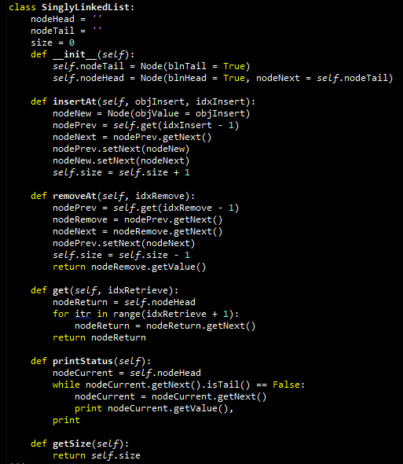
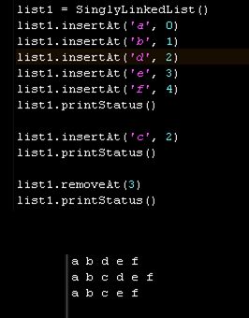
Implementation of Singly linked list
Empty Linked List
Object
N e x t
Object
N e x t
Head
Tail
Notes:
So far, we’ve covered the insertion and removal process of elements.
Now, we examine a linked list from a different viewpoint: the level of code.
Basically, we call a constructor, SinglyLinkedList.
The constructor is here.
The constructor then generates nodeTail and nodeHead.
The head and tail are produced by instantiation
As you see here, when the tail is generated, blnTail becomes True. To make the head, True is placed in blnHead and takes over the tail from nextNode to complete a SinglyLinkedList.
Let’s say we are carrying out an “insert” as follows.
To perform insertAt, we should make nodeNew and put data to store in objectValue.
It is necessary to make a constructor by performing a node instantiation.
I won’t go into detail, but “get” here is a function that can fetch a node in a specific place in a list through a “for” loop.
nodePrev is used to determine what to insert. idxInsert – 1 refers to the node right before the one to be stored.
nodeNext is the next node of the nodePrev.
The next of the nodePrev should be nodeNew. Let me illustrate this with a figure.
Here, we have nodePrev and nodeNext.
We also have nodeNew at this point.
Our job is to make the next of the node to point to nodeNew with setNext in the nodePrev.
We will break the existing connection to make a new link.
We should make sure that nodeNew points to nodeNext.
We link the next of nodeNew with the nodeNext with the following code.
Finally, we conclude the insertion by increasing the size of the linked list.
Next, we will look at how to remove an element.
First, let’s suppose that there is a command to bring a node in a specific place with self.get.
Likewise, we get nodePrev.
Then, nodeRemove will be the getNext of the nodePrev.
nodeRemove is currently linked like this.
The nodeNext is the getNest of the nodeRemove.
This is the next connecting to the nodeRemove.
In order to remove the nodeRemove, the nodePrev should not be directed to the nodeRemove, but nodeNext.
Therefore, we should make sure that the setNext of the nodePrev turns into the nodeNext.
The process gets rid of the nodeRemove as it is overridden by the next of the nodePrev.
Finally, we will reduce the size and return the value of the eliminated node.
I recommend that you try implementing this type of code.
The code-like node should be implemented in a way so that it uses a different file other than this class.

Slide 20
Stack and Queue
Notes:
This time, we will examine some data structures, such as stack and queue, based on a linked list.

Slide 21







Scenario for Stack
Back seat of a taxi
One way in and out
We are traveling from the source to our destinations
Who should seat first and last?
A scenario for a taxi = A scenario for SCM
A cargo plane with one way in and out
How to organize the cargo loading to the plane?
Notes:
Let’s examine a scenario involving a stack.
Imagine this.
Prof. Lee Taesik, Prof. Shin Hayong, and I are about to get back home by taxi.
We don’t live in the same place, but we’re both taking the same taxi home.
What’s the best way for us to sit in the back seat of the taxi?
Now, it is customary in Korea to get off from the right-hand side first. In this case, Prof. Lee should be the last person to get on the taxi because he will be the first to get off: I should get in first as I am the last person to get off. When I get in, I’ll be followed by Prof. Shin and Prof. Lee.
As we know when the passengers should get off, we’ve decided which seats to take in advance.
Let’s consider the situation in an airplane.
Baggage is unloaded from the rear of the airplane. Baggage whose destination airport is last to be placed in the back. Baggage for the closest destination is placed in the front. This arrangement makes the job of loading and unloading baggage easier.
In an airplane, there is usually just one exit for unloading baggage. A stack is very similar to this: it is a structure that has only one location to add or delete data.
Let’s review the structure of a stack in detail.

Slide 22
Structure of Stack
Top Only Accessible
Stacks are linear like linked lists
A variation of a singly linked list
Difference
Voluntarily giving up
Access to the middle in the linked list
Only accesses to the first instance in the list
The first instance in the list
= The top instance in the stack
An item is inserted or removed from the stack from one end called the “top” of the stack.
This mechanism is called Last-In-First-Out (LIFO).
Cargo Object 1
Cargo Object 2
Cargo Object 3
Cargo Object 4
Cargo Object 5
Cargo Object 6
Notes:
The structure of a stack is like this.
Just like a linked list, a stack is linear.
In other words, it is connected in a linear way.
A stack can be seen as the modification of a singly linked list.
Other data structures allow taking data in and out of the linked list.
A stack, however, doesn’t work like this.
When a stack is intentionally defined, it means that it would not intervene with anything in the middle or the ends of the linked list.
It will put data in or out via the first node only.
Let’s call the 1st node the “top”.
The “top” is the only way to insert or delete the data.
The 1st instance is called the top of the stack.
Only insert and remove is called via top. This mechanism is called Last-In-First-Out or LIFO.
Let’s take a look at object 6 in the stack.
Obviously, object 6 should be entered through the top of this stack.
This object 6 was the first item to come.
The stack structure was completed by inserting from object 6 to object 1 in sequence.
The first item to come will leave last. So, in this case, object 1 at the top will leave the stack first.

Slide 23





Operation of Stack
Stack operation
Push
= Insert an instance at the first in the linked list
= Put an instance at the top in the stack
Pop
= Remove and return an instance at the first in the linked list
= Remove and return an instance at the top in the stack
Push
Moon
Push
Shin
Push
Lee
Pop
Lee
Pop
Shin
Pop
Moon
Notes:
Let’s define the operations in a stack.
In a list, we were able to carry out “search”, “insert”, and “delete”.
As for a stack, the top is the only item disclosed. We cannot do a search, but we can insert elements through the top. In this regard, insert is referred to as “push” while delete is called as a “pop”. That’s because the “top” is the only place where items from the stack can be removed.
In the taxi example, we first pushed Prof. Moon Il-Chul, followed by Prof. Shin Hayong and Prof. Lee Taesik.
We will pop in the order of Prof. Lee Taesik, Prof. Shin Hayong and Prof. Moon Il-Chul to complete the stack.
If so, how can we implement “push” and “pop”?
If we have a list inside the stack, the push operation involves inserting an instance for the first time.
We can always conduct “push” by inserting the first element.
Pop serves to remove an element. We perform that operation by removing the first element of a linked list.
This will allow us to implement “push” and “pop” with “insert” and “remove” by putting a linked list in a stack.

Slide 24
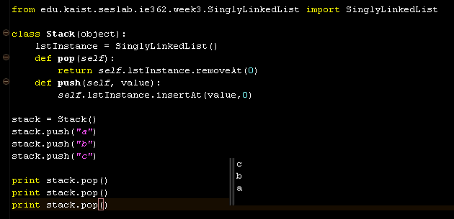
Implementation of Stack
Python code of a stack
Utilizing a singly linked list
To pop an instance
1 retrieval count
To push an instance
1 retrieval count
Notes:
A stack can be implemented through Python code.
First, we need to declare the stack within which SinglyLinkedList is declared with member variables.
What we are actually operating is “pop” and “push”.
The function of a pop always involves eliminating an item at the top.
As it always handles what’s on top by using a SinglyLinkedList named self.lstInstance, it will remove a fixed index.
The same goes for “push”. We can create a push operation by inserting a value into the predetermined 0th index as always.
As such, we can simply implement a stack by using a linked list.

Slide 25
Example: Balancing Symbols
Balancing symbols?
[2+(1+2)]-3 → Symbols are balanced
[2+(1+2]-3 → Symbols are not balanced
Then, just counting opening and closing symbols?
What if? [2+(1]+2)-3
Algorithm for the balanced symbol checking
Make an empty stack
read symbols until end of formula
if the symbol is an opening symbol push it onto the stack
if it is a closing symbol do the following
If the stack is empty report an error
Otherwise pop the stack.
If the symbol popped does not match the closing symbol report an error
At the end of the of formula if the stack is not empty report an error
7+{[2+(1+2)]*3}
(
[
[
{
{
{
[
{
{
Notes:
A stack can also be utilized in calculations.
There is a balancing symbol problem.
Here, you will find curly brackets, brackets, and parentheses.
It well defines the relationships between opening and closing.
In this case, the symbol strikes the right balance.
But this case isn’t well balanced.
That’s because the parentheses don’t match here.
This case does not make a good balance.
That’s because it starts with an open parenthesis, but it ends in a bracket.
Thus, the opening and closing structures do not match.
Employing a method-solving method called an algorithm, we will check if a balance is met.
First, we will make an empty stack and read the symbols till the end of formula.
If the symbol is an opening symbol, it will invariably push a stack.
If you look at this example, whenever an opening bracket is found, it will push a stack.
If there is a close symbol with an empty stack, an error occurs.
This means that when a close symbol is entered, but it fails to match an open symbol, an error will occur.
As for “pop”, if the style of the popped bracket does not match that of the closed symbol, it will also lead to an error.
When no errors occurrs throughout the formulas with an empty stack, it can be said to have a good balance.
This example shows a good match. The parenthesis comes in as a close symbol for popping, and it’s followed by an open parenthesis.
Likewise, the brackets and curly brackets are perfectly matched. The empty stack after the equations confirms that this code is well balanced.

Slide 26

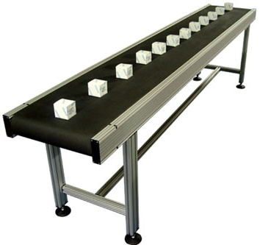
Scenario for Queue
Line at an airport
A way for going in
At the end of the line
Another way for going out
At the first of the line
No one gets in the middle of the line
A scenario of a line at the airport = A scenario of a production line at a factory
The first product out is the first product in
How to track the production line?
Notes:
Now that we’re a bit familiar with stacks, let’s look at queues.
Let’s consider an example of a queue.
People are in a line, or a queue, to enter an airport.
This is the direction for the line, and people enter the line from the back.
The first person will leave the line first, and the last person will leave the line last. This queue follows a First in, First out structure.
It is a different from a stack since its entry and exit differ from each other.
The process of producing products is similar.
As a conveyor belt runs, products go in and out, one by one.
Thus, it differs from the stack as the points of entry and exit are different.
Nothing can also be inserted in the middle.
It is analogous to the production process in a factory.
The product the enters the production process first is also released first.
A data structure with this kind of structure is called a queue.

Slide 27
Structure of Queue
Queues are linear like linked lists
A variation of a singly linked list
Difference
Voluntarily giving up
Access to the middle in the linked list == Same to the stacks
Only accesses to the first and the last instances in the list
The first instance in the list
= The front instance in the queue
The last instance in the list
= The rear instance in the queue
An item is inserted at the last
An item is removed at the front
This mechanism is called Fast-In-First-Out (FIFO)
Product 1
Product 2
Product 3
Product 4
Notes:
Let’s probe into the structure of a queue.
In some respects, a queue can be seen as the modified version of a singly linked list.
It differs from the singly linked list in that it abandons any access to the middle. It only allows entry and exit at the rear and front.
Entrance can only be done at the front, and exit can only be done at the rear.
As such, the first instance can only exit via the last instance.
This mechanism is called FIFO.
Product 1 gets in at this part, and it’s followed by others in a sequence.
As they come out in order, Product 2 only becomes available after the exit of Product 1.

Slide 28


Operation of Queue
Enqueue Lee
Queue operation
Enqueue
= Insert an instance at the last in the linked list
= Put an instance at the rear in the queue
Dequeue
= Remove and return an instance at the first in the linked list
= Remove and return an instance at the front in the queue
Enqueue Shin
Enqueue Moon
Dequeue Lee
Dequeue Shin
Dequeue Moon
Notes:
Let’s compare a queue with a list to better understand how a queue operates.
A list has “insert” and “remove” functions.
Just like a stack, a queue gives up access in the middle stages. It is easily implemented with adequate handling of a specific index in a list.
An enqueue is equivalent to an insertion.
An enqueue inserts an element into the last location. This plays the role of “insert” in a queue.
A dequeue removes the 1st element.
For instance, Prof. Moon, Il-Chul, Prof. Shin Hayong, and Prof. Lee Tae-sil are about to line up at an airport.
They will exit from here and enter from there.
For enqueueing, we would put them in the order of Prof. Lee, Prof. Shin, and Prof. Moon. For dequeuing, as it is a FIFO structure, the order of exit will be: Prof. Lee, Prof. Shin and Prof. Moon.

Slide 29
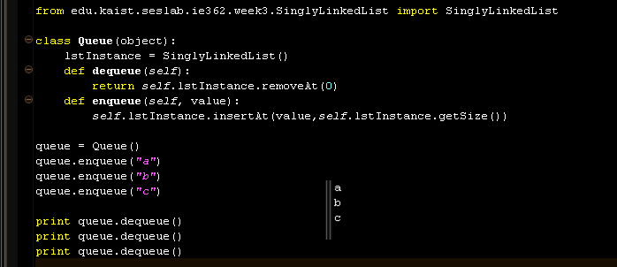
Implementation of Queue
Python code of a queue
Utilizing a singly linked list
To enqueue an instance
1 retrieval count
To dequeue an instance
1 retrieval count
Notes:
Let’s review how to implement a queue with code.
As a queue also uses a list, we will employ singlyLinkedList.
The two operations defined before would be implemented like this.
A dequeue is about eliminating the first element.
The index is fixed to the 0th place.
We can just return what comes out as the first element.
What matters here is the enqueue.
That’s because its size can vary.
For example, 1 is enqueued, 2 is enqueued, and 3 is enqueued to be inserted in the relevant index.
In other words, an enqueue tends to vary according to different list sizes.
An enqueue operation involves discovering the size of a list and placing values in the relevant locations.
In the case of a stack, we just need to use 0 index as the element that is defined as the front. Here, we have to find out the size of the list and insert it in the index if we intend to implement a queue.

